Slide 1
Team Circuit X
DONE BY:
GOKUL N(717824V118)

Slide 2
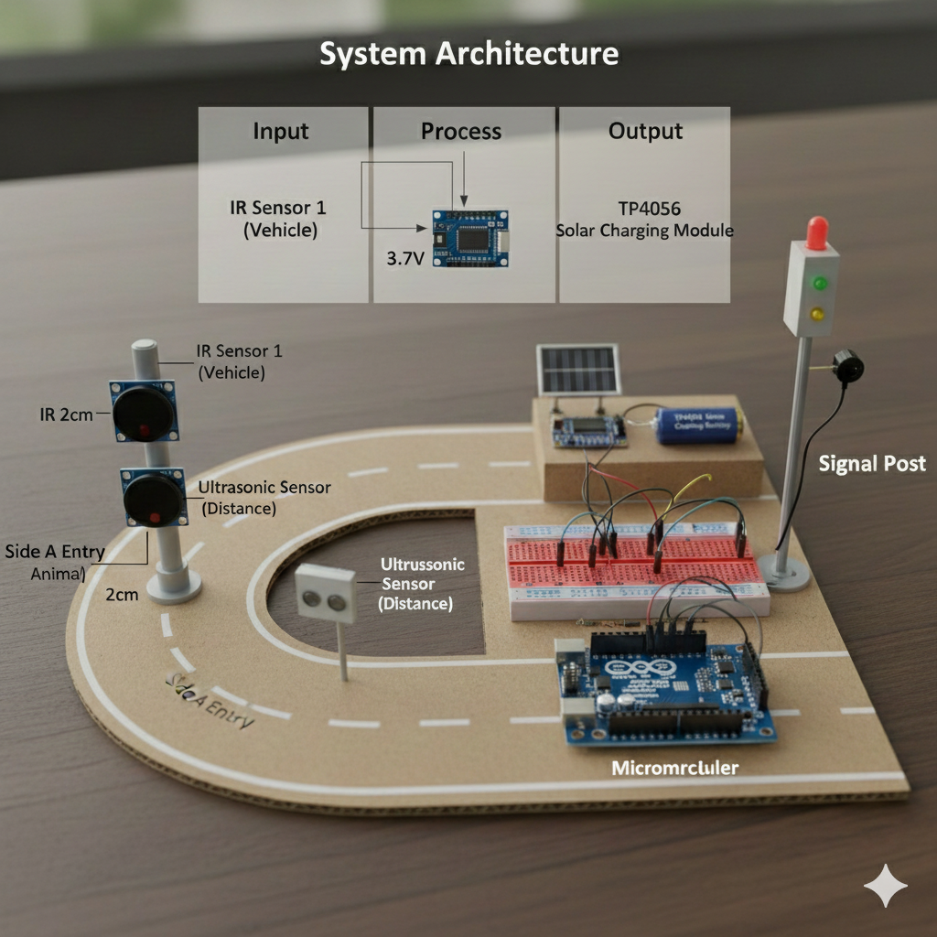
Smart Hairpin Bend Accident Prevention System
Vehicle Detection & Warning System for Hilly Roads
Technology: Embedded Systems | IoT (Basic

Slide 3
PROBLEM STATEMENT
Road accidents frequently occur at hairpin bends in hilly areas due to poor visibility, blind curves, fog, and the absence of early warning systems. Drivers approaching these bends often fail to notice vehicles coming from the opposite direction, resulting in collisions and loss of life. Existing solutions such as mirrors and static signboards are insufficient, especially during night and low-visibility conditions. There is a strong need for a low-cost, autonomous, and real-time warning system that can actively alert drivers before they enter dangerous curves.

Slide 4
SOLUTION
This project proposes a Solar Powered Smart Hairpin Bend Accident Prevention System using ultrasonic sensors, Arduino, LEDs, and buzzers. Two sensors are installed on both sides of a blind curve. When a vehicle approaches from one side, the system immediately triggers a warning light and buzzer on the opposite side, alerting drivers in advance. The system is powered by solar energy with battery backup, making it suitable for remote hilly regions where grid power is unavailable. This solution directly addresses the problem of late reaction time and lack of visibility at sharp bends.

Slide 5
Opportunities
How is it different from existing ideas?
Most existing systems use mirrors or single-sensor detection, which are unreliable in fog or darkness.
Our solution uses dual-direction sensing, active alerts, and solar-powered autonomous operation.
It provides real-time intelligent warnings, unlike passive signboards.
How will it solve the problem?
Detects vehicles before they enter blind curves.
Warns the opposite driver using visual and sound alerts.
Reduces collision probability by increasing reaction time.
Works 24/7 even in remote locations without electricity.

Slide 6
List of Features Offered by the Solution
Dual ultrasonic vehicle detection
Real-time warning using LED and buzzer
Solar-powered with battery backup
Low-cost and easy to install
Works in night, fog, and low-visibility conditions
Autonomous operation without human intervention
Scalable for multiple road bends
Environment-friendly energy usage

Slide 7
Google Technologies Used in the Solution
Google Slides – PPT creation and presentation
Google Docs – Project documentation and report writing
Google Search – Research and technical reference
Google Drive – File storage and collaboration

Slide 8
Use Case Description
Process Flow:
Vehicle approaches the hairpin bend.
Ultrasonic sensor detects the vehicle.
Arduino processes the sensor signal.
Warning LED and buzzer activate on the opposite side.
Driver receives early warning and slows down.
Accident risk is reduced.
Use Case:
Actor: Driver
System: Smart Hairpin Bend Safety System
Action: Vehicle detection → Warning alert → Safe driving decision

Slide 9
Wireframes / Mock Diagrams of the Proposed Solution
. Sensor unit placed on both sides of the curve.
LED warning boards visible to approaching drivers.
Central controller (Arduino) connected to sensors and alerts.
Solar panel mounted on roadside pole powering the system.

Slide 10
System Architecture

Slide 11
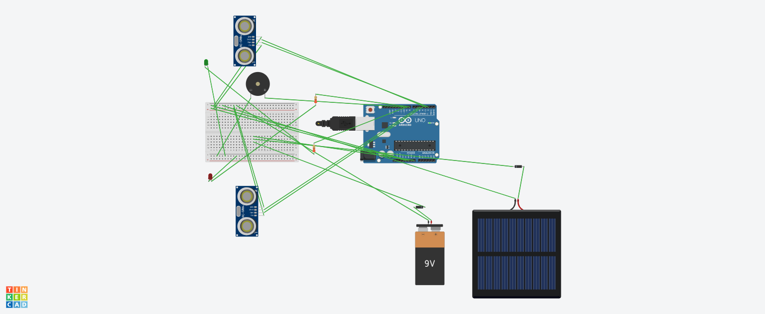
Snapshots of the MVP
Tinker cad circuit simulation showing:
Two ultrasonic sensors connected to Arduino
LEDs and buzzer as output alerts
Battery and solar power supply connections
Working simulation where:
Sensor A detection triggers LED B
Sensor B detection triggers LED A

Slide 12
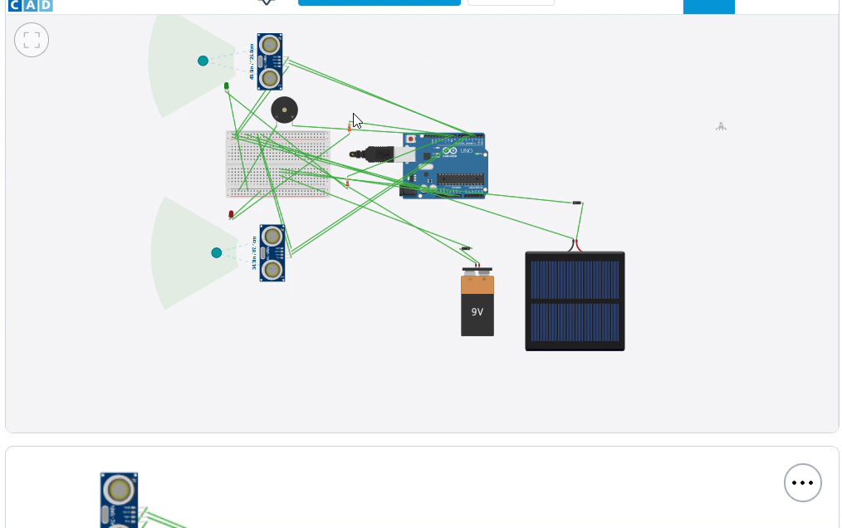
MODEL SIMULATION VIDEO

Slide 13
Future Development
Integration with IoT platforms for remote monitoring
Mobile app notifications for drivers
Speed detection and overspeed warning system
GSM-based emergency alert to authorities
AI-based traffic pattern analysis
Weather-based adaptive warning system
Real-world deployment using weatherproof enclosures

Slide 14
CONCLUSION
The proposed system improves safety at hairpin bends.
It provides timely warnings to drivers.
Simple, effective and practical solution for hilly roads.
Helps in reducing accidents and saving lives.

